Slide 1
ENSE706 - Data Process and Software Modelling Assessment Phase 1
Presented by Thanh Tran

Slide 2
Selected organisation – AUT
Auckland University of Technology (AUT), a public university in New Zealand
Established in 2000; one of the largest tertiary institutions in NZ
Has 26,708 students and 4,046 staff in 2025
Operates across multiple campuses with a wide range of programmes
Large-scale and complex organisational structure

Slide 3
Key departments
Academic Departments (Faculties): Course delivery, curriculum, research (5 faculties, 15 schools)
Student Services: Enrolment support, counselling, academic and career advice
Academic Registry: Manages enrolments, records, timetables, graduation
IT Department: Digital infrastructure, authentication, cybersecurity, system support
Finance Department: Fees, budgeting, procurement, financial reporting

Slide 4
Key system
Departments require coordinated information systems
Some key systems:
Course Enrolment System (focus of this project)
Student Information System
Course Information System
Finance System
HR System
Highlights need for integrated and efficient system support

Slide 5
Problem statement
Current AUT enrolment process is manual and paper-based
Causes issues such as:
Lost or misplaced enrolment forms
Manual prerequisite checking errors
Delays in enrolment approval (peak periods)
Difficulty tracking course capacity and student progress
Inconsistent data and poor inter-department coordination
Need for a Course Enrolment System to improve efficiency, accuracy, and accessibility

Slide 6
System Requirements & Integration
Web-based system for course search, enrolment, and management
Integrates with:
Student Information System
Course Information System
HR System
Finance System
Supports:
Domestic and international students
Timetable clash detection and visualisation
Prerequisite and capacity validation
Real-time enrolment status updates

Slide 7
Stakeholders / User Roles
Students: search courses, view timetable, enrol, manage requests
Academic department staff: manage course details and updates
Academic registry staff: approve/reject enrolments
Finance staff: monitor payments and handle exceptions
IT staff: system maintenance and support
System administrators: user access control and security

Slide 8
System Scope & Boundaries
Scope:
Course search, selection, and enrolment
Enrolment validation (prerequisites, capacity, timetable conflicts)
Approval workflows
System integration for data retrieval
Timetable visualisation
Boundaries:
Excludes grading, transcripts, teaching, payroll
Does not directly modify external system data

Slide 9
Assumptions
Users have internet access and web browser
Users are pre-authenticated by AUT
External systems provide accurate data
System supports multiple concurrent users
Standardised workflows across departments
Integration with AUT systems is available

Slide 10
Requirements Engineering
Requirements Elicitation Methods
Problem statement analysis
Existing document analysis (AUT enrolment guideline)
Observation of current manual enrolment process
Stakeholder interviews (academic, registry, IT, finance staff)
Questionnaires for additional validation
Key Outcome of Elicitation
Identified inefficiencies in manual enrolment process
Defined need for an integrated Course Enrolment System
System must support multiple departments and external system integration

Slide 11
Functional Requirements
Some key functional requirements:
User login and role-based access control
Course search, selection, and enrolment
Prerequisite, capacity, and timetable validation
Enrolment approval workflow
Payment status integration (Finance System)
Real-time enrolment tracking and notifications
Timetable visualisation and clash detection
System administration and audit logging

Slide 12
Non-Functional Requirements
Some key non-functional requirements:
Performance: supports 5,000+ concurrent users, fast response time
Security: encrypted data, secure authentication, session control
Reliability: 99.5% uptime, backup and recovery support
Compatibility: web browser support + system integration
Scalability: supports future growth (10,000+ users)
Usability: user-friendly interface and clear error messages

Slide 13
UML Requirements Modelling
Translates functional requirements into visual system behaviour
Uses use case modelling to show system interactions
Defines system boundaries and user-system relationships
Ensures all stakeholder requirements are captured
Provides foundation for system design and implementation

Slide 14
Actors
Primary Actors:
Student
Academic Department Staff
Academic Registry Staff
Finance Staff
System Administrator
IT Staff
External System Actors:
Student Information System
Course Information System
Finance System
HR System

Slide 15
Use Cases
Some key use cases:
User login and role-based access
Course search, selection, and enrolment
View course details and timetable
Enrolment submission and tracking
Prerequisite, capacity, and clash validation
Enrolment approval workflow
Payment processing and verification
System administration and audit logging

Slide 16
Use Case Relationships
Include
Core validations (prerequisites, capacity, clashes)
Data retrieval (student, course, finance, HR info)
Audit logging and timetable view
Extend
Notify enrolment issues
Modify enrolment request
Handle payment exceptions
Generalisation
Staff → Academic, Registry, Finance, IT, Admin
External Systems → SIS, CIS, Finance, HR

Slide 17
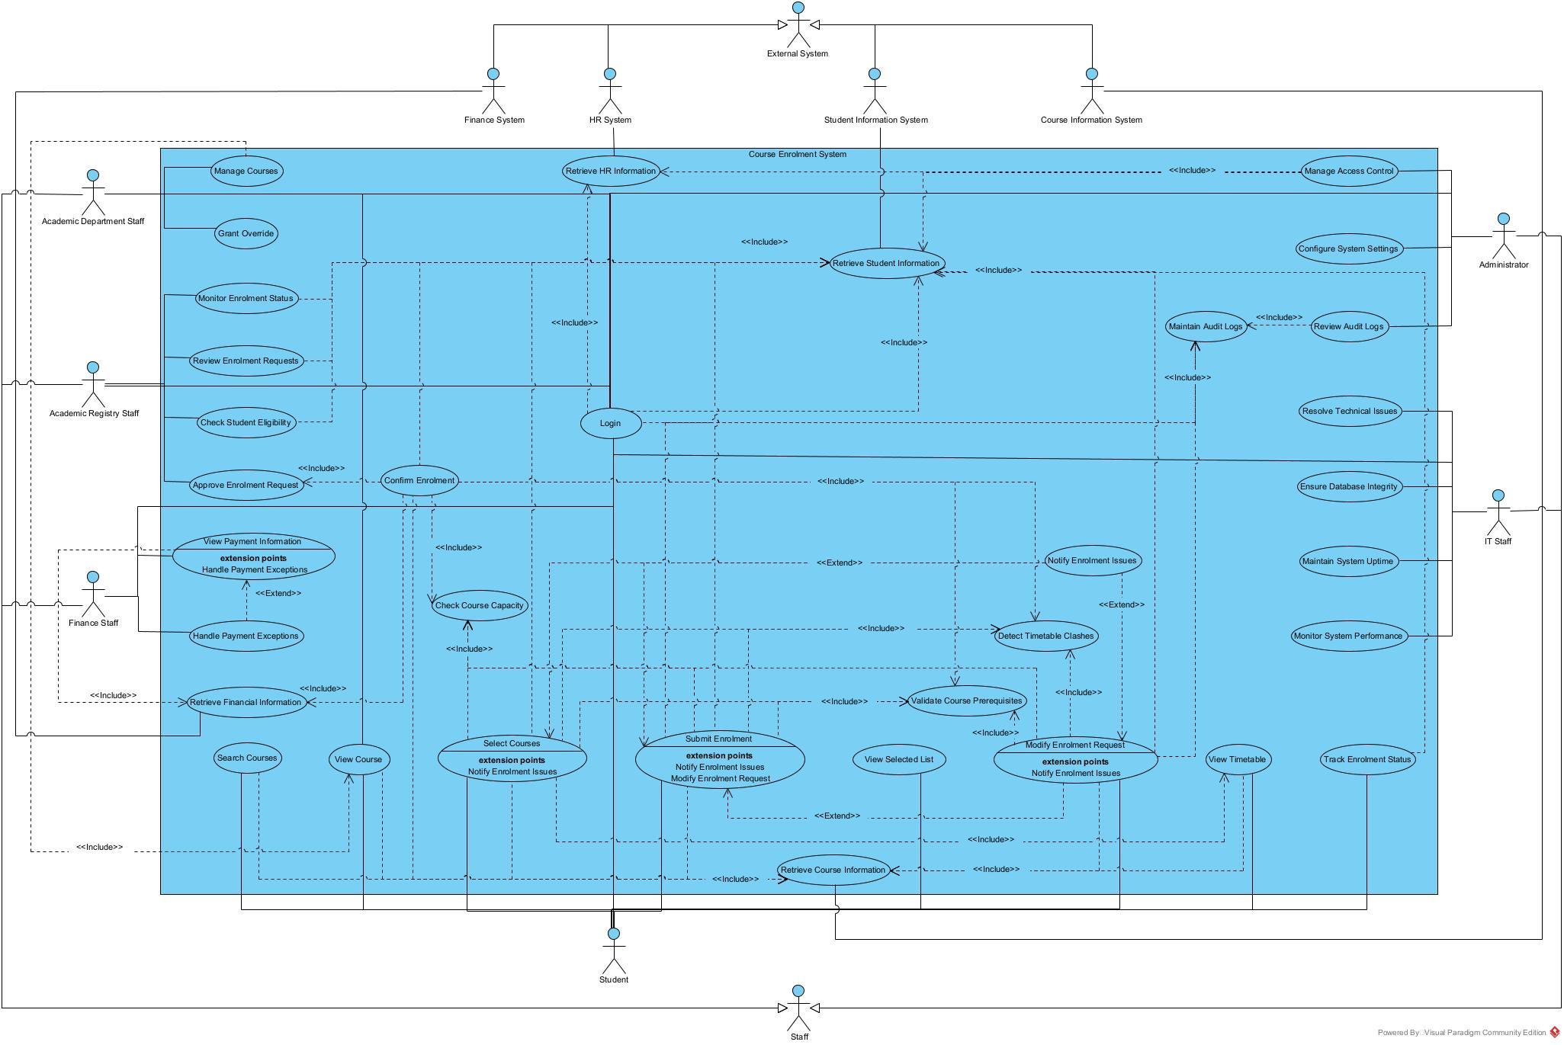
Use Case Diagram

Slide 18
UML Class Diagram
Translates system requirements into a structural UML class model
Defines system classes, attributes, operations, and relationships
Forms the foundation for system implementation

Slide 19
Identified Classes
Core Domain Classes
User (Abstract)
Student
Staff (Abstract)
AcademicStaff
RegistryStaff
FinanceStaff
ITStaff
SystemAdmin
Course
Timetable
EnrolmentRequest
Enumerations
StudentType
EnrolmentStatus
Service Layer Classes
EnrolmentService
ValidationService
TimetableService
FinanceService
NotificationService
AuditService
Integrated Systems
ICourseInfoSystem
IStudentInfoSystem
IFinanceSystem
IHRSystem

Slide 20
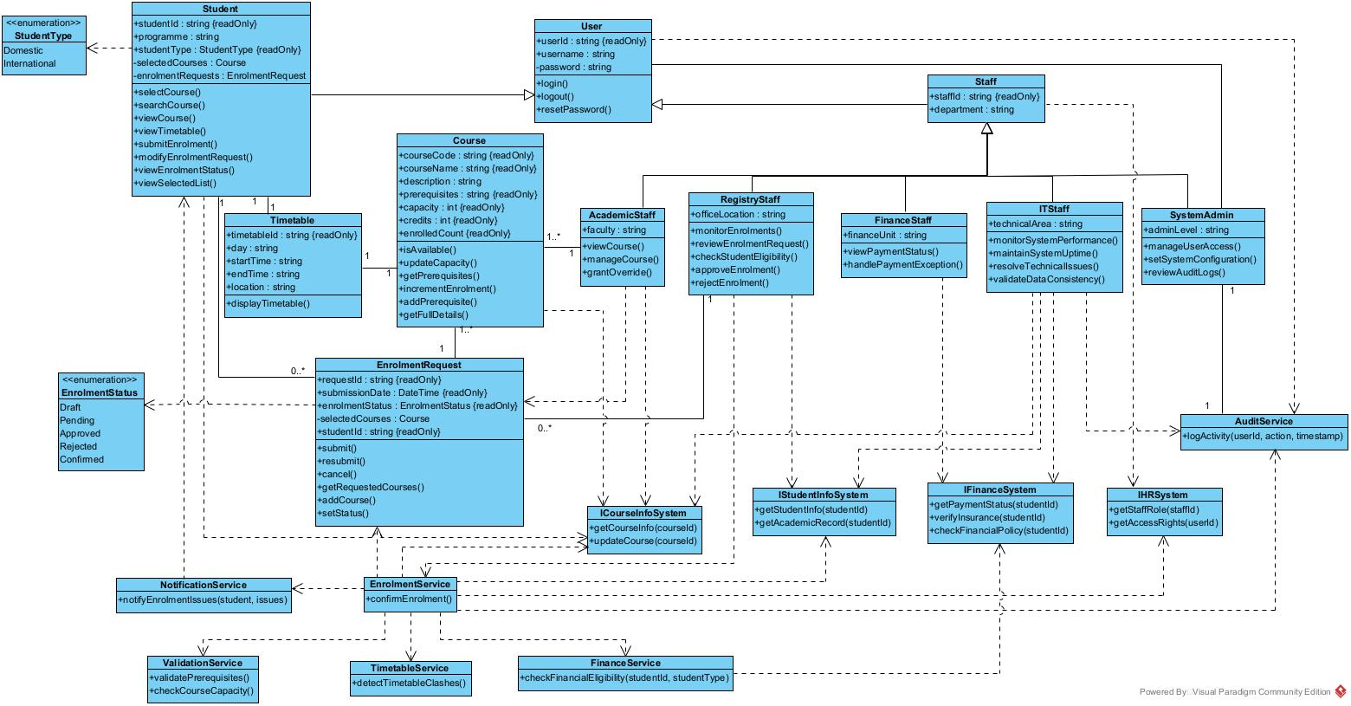
Class Diagram

Slide 21
Thank You For Listening!

